Slide 1
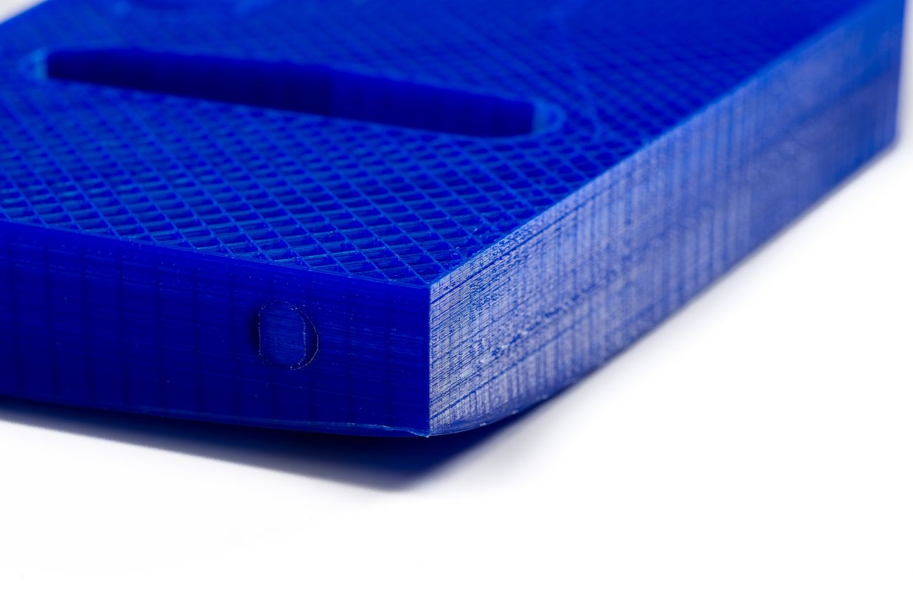
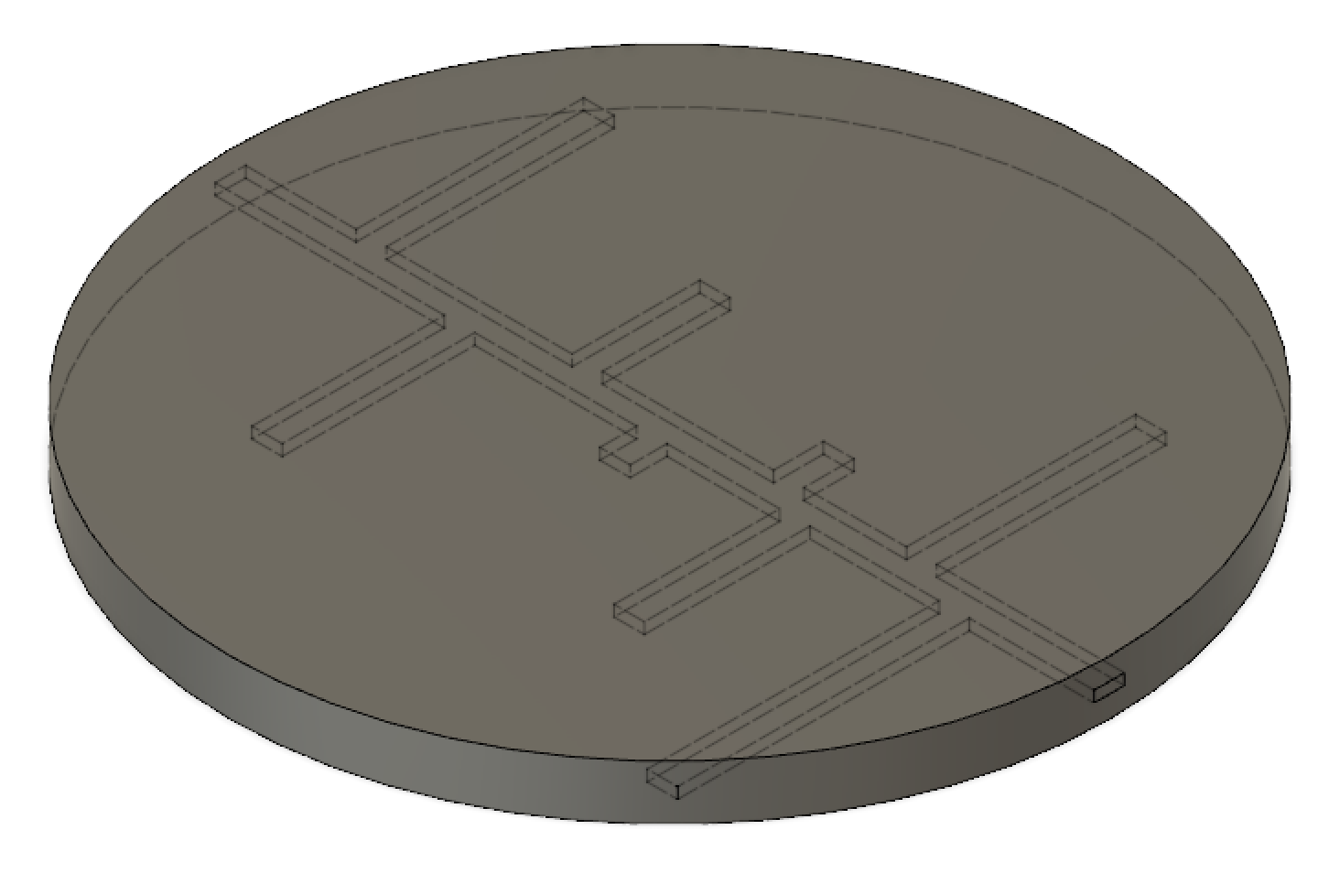
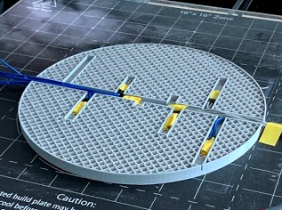
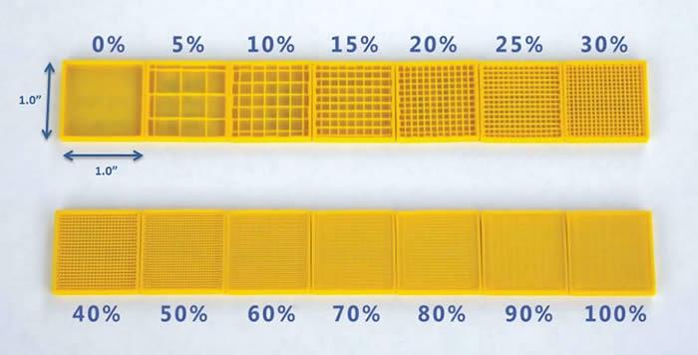
PURPOSE
The Effect of Infill Parameters on Spatiotemporal Thermal Distribution in Fused Deposition Modeling
RESULTS
3D printing has grown into a widely explored technology in many industries, such as construction, aerospace, and medicine, because of its ability to rapidly produce prototypes.
For many of these industries, the thermal properties of products are crucial to functionality. Therefore, it is critical to understand specific factors that influence these thermal properties.
During the 3D printing process, thermal stresses creates distortions, known as warpage. Limited research has been done on solutions to the warpage problem in FDM printing.
This study aims to understand the relationship between infill parameters and the spatiotemporal temperature distribution during the printing process.
more results space if needed
EXPERIMENTAL DESIGN
Designed CAD model of an 8-inch diameter, 0.5 inch thick disc with 14mm wide channels
Sliced the model three times using a rectilinear infill pattern with 10%, 20%, and 30% infill percentage
Print the sliced model on the gCreate gMax 1.5XT+ with PLA and print settings in Table 1
Embed 8 NTC thermistors into the channels and record data using an Arduino Voltage Circuit and puTTY
Table 1: Printer Settings for All Prints. Settings not mentioned were left as the default values.
Setting | Value
Extruder Temperature | 200°C
Bed Temperature | 80°C
Layer Height | 0.2 mm
Figure 1: Warpage in 3D printing
3dprinting.com/tips-tricks/how-to-choose-an-infill-for-your-3d-prints
Figure 3: CAD Model of Template Disc
Figure 4: Embedding Thermistors during Printing
BACKGROUND
DATA
CONCLUSIONS
Fused deposition modeling (FDM) is the most popular method for 3D printing due to its low production costs. In FDM, a thermoplastic filament is melted and extruded onto a surface repeatedly to produce a 3D object.
Warpage occurs as cycles of heating and cooling layers cause thermal stresses of expansion and contraction.
Plastic is used as filament in 3D printing. The discontinuous atomic nature of plastic causes its heat properties to be anisotropic and influenced by the internal structure, or infill.
Infill percentage refers to the proportion of plastic in an 3D printed object.
Current research on this topic fails to account for environmental factors as well as failing to consider factors that affect thermal properties.
Table 2: Sample Section of Raw Data from 20% Infill Print
I HAVE NO IDEA WHAT J HAPPEND
Time (seconds) | Thermistor 1 (°C) | Thermistor 2 (°C) | Thermistor 3 (°C) | Thermistor 4 (°C) | Thermistor 5 (°C) | Thermistor 6 (°C) | Thermistor 7 (°C) | Thermistor 8 (°C)
618 | 31.93 | 30.48 | 28.34 | 29.41 | 24.36 | 26.66 | 24.46 | 26.26
619 | 31.84 | 30.09 | 28.14 | 29.31 | 24.36 | 26.66 | 24.56 | 26.36
620 | 31.84 | 29.7 | 27.94 | 29.31 | 24.46 | 26.56 | 24.46 | 26.36
621 | 31.84 | 29.41 | 27.75 | 29.22 | 24.56 | 26.56 | 24.46 | 26.36
622 | 31.84 | 29.12 | 27.65 | 29.31 | 24.66 | 26.46 | 24.46 | 26.36
623 | 31.84 | 28.92 | 27.55 | 29.31 | 24.56 | 26.46 | 24.36 | 26.36
624 | 31.84 | 28.63 | 27.55 | 29.61 | 24.66 | 26.36 | 24.36 | 26.36
RESULTS
Lots of stuff goes here
FUTURE WORK
SAVE URSELF AND DON’T DO MORE WORK
Figure 2: Various Infill Percentages
tcadsolutions.com/3dprinting.html
HYPOTHESIS
Greater infill percentages will have more uniform distributions of temperature because conduction has been shown to be more effective than radiation or convection for heat transfer in enclosed structures.
IV: Infill percentage (10%, 20%, 30%)
DV: Temperature at specific points over time

